Slide 1
Linux Power
Basic, Linux PM, DVFS, OPP, Runtime PM, PM QoS
국민대학교 임베디드 연구실
경 주 현
2017 LG MC 인재육성팀 교육

Slide 2
Outline
Processor Power Management
Linux Power Management

Slide 3
How to reduce power?

Slide 4
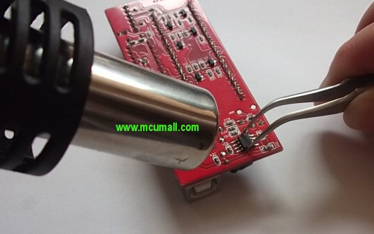
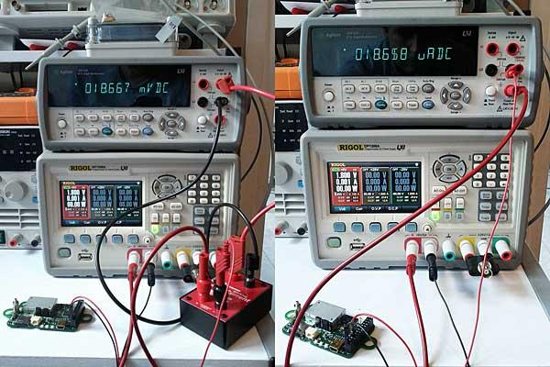
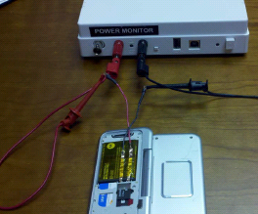
How to reduce power?
WIFI, Modem chip, LCD, Touch ....
Power Rail Check
Total Current Check

Slide 5
Background
Energy
joule
Power
watt
Processor Power Management
P-state, C-state

Slide 6
Processor Power Management

Slide 7
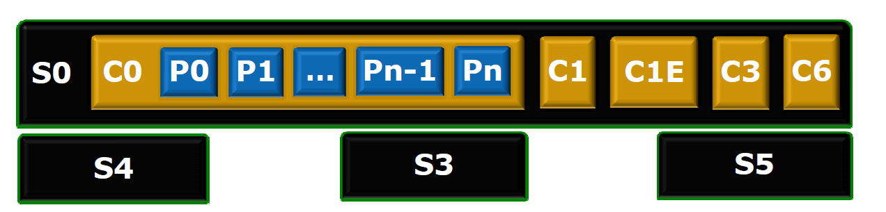
Silicon Power Management Features
P – States are a sub-state of the C0 state
They offer reduced power consumption while the processor is executing code.
C-States are a sub-state of the S0 state
They offer reduced power consumption while the system is fully on.
S-States
Suspend to idle, Standby, Suspend to ram, suspend to disk

Slide 8
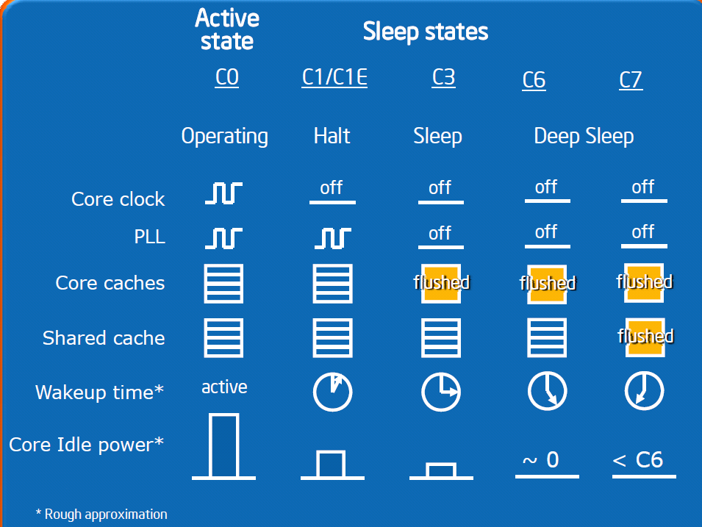
Processor Power Management
CPU C-State (Idle Power State)
C0 - Full On State
C1 – Auto Halt State
C2, C4 (C3, C4, C5), C6
CPU P-State (Performance State)
http://download.intel.com/embedded/technology/PowerManagementforEmbeddedApps.pdf

Slide 9
Silicon Power Management Features
Advanced Configuration and Power Interface (ACPI)
Performance state(P-states)
P0 : highest performance, highest power
P1 ~ Pn : lower frequency and voltages
Throttling states(T-states)
T1~Tn : change only frequency not voltage for thermal
Performance State Px
Throttling
C0
C2
Idle(stops CPU main internal clocks via HW)
C1
C3
Idle(stops CPU main internal clocks via SW)
Idle(stops All CPU internal clocks, not kept cache coherent)

Slide 10
Linux Power Management

Slide 11
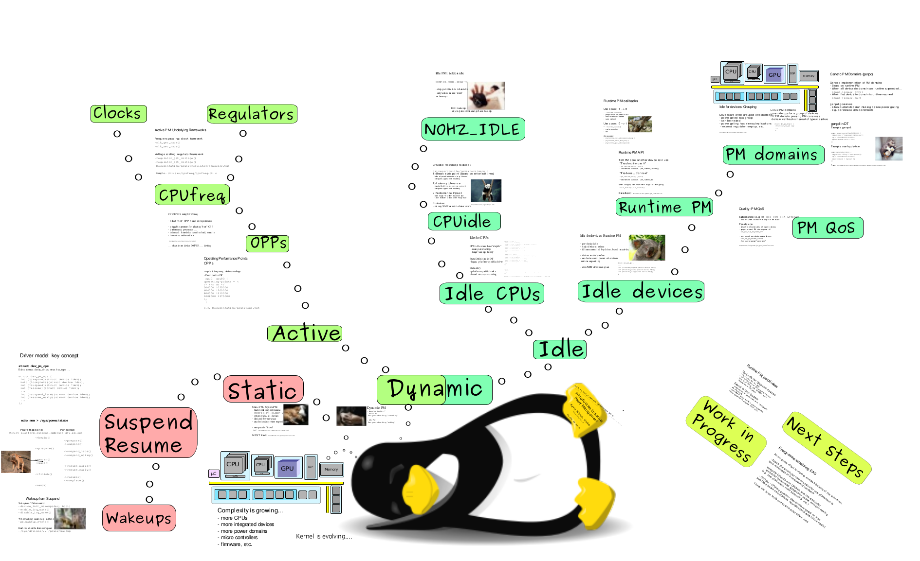
Tree view - Dynamic and Static PM
Reference from "Introduction to Kernel Power Management" Kevin Hilman, Linaro

Slide 12
Linux Driver Model
Example
static struct device_driver eepro100_driver = {
.name = "eepro100",
.bus = &pci_bus_type,
.probe = eepro100_probe,
.remove = eepro100_remove,
.suspend = eepro100_suspend,
.resume = eepro100_resume,
};

Slide 13
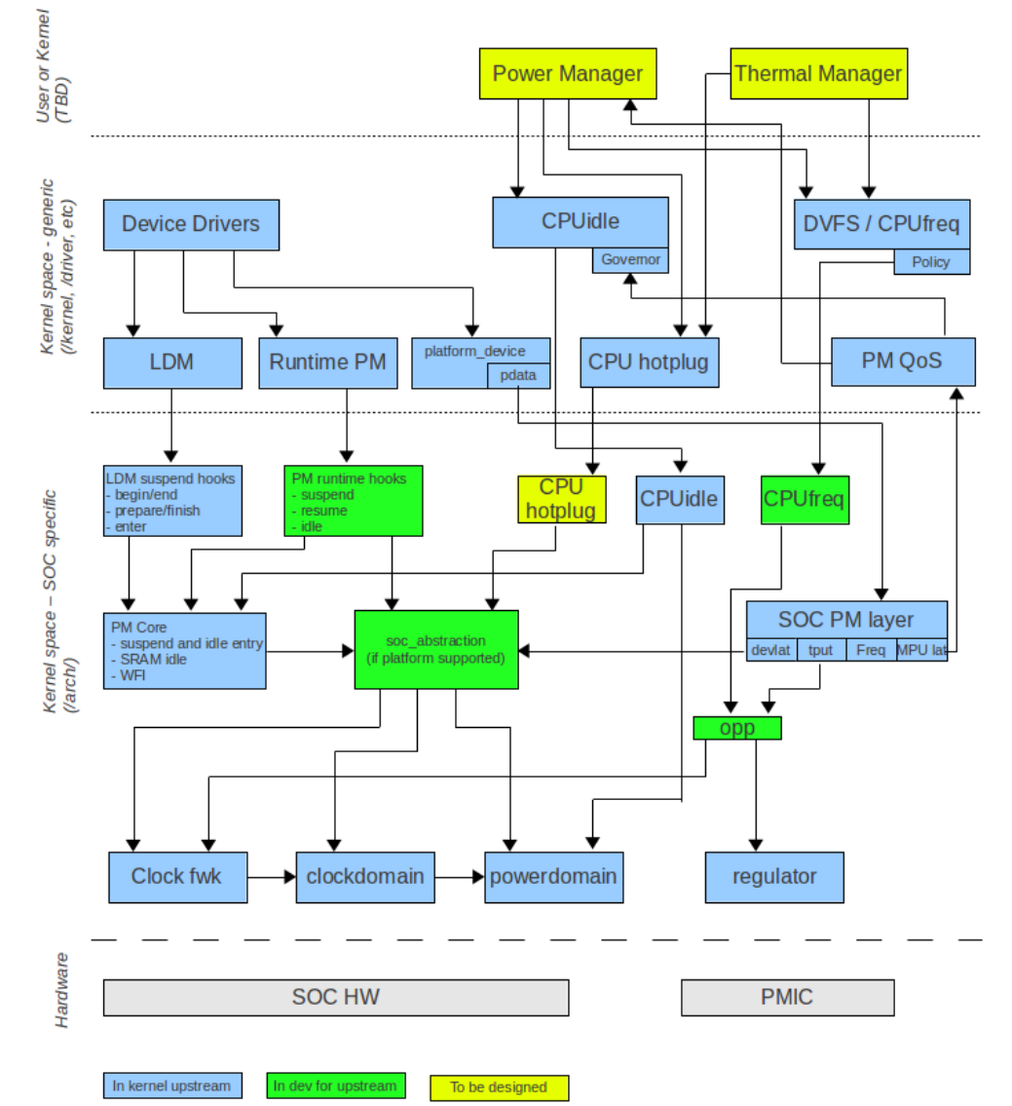
Linux Power Framework
https://wiki.linaro.org/WorkingGroups/PowerManagement/Doc/Architecture
Source : https://wiki.linaro.org/WorkingGroups/PowerManagement/Doc/Architecture

Slide 14
Linux Driver Model
https://wiki.linaro.org/WorkingGroups/PowerManagement/Doc/Architecture
Source : https://wiki.linaro.org/WorkingGroups/PowerManagement/Doc/Architecture

Slide 15
Tree view - Dynamic and Static PM
Reference from "Introduction to Kernel Power Management" Kevin Hilman, Linaro

Slide 16
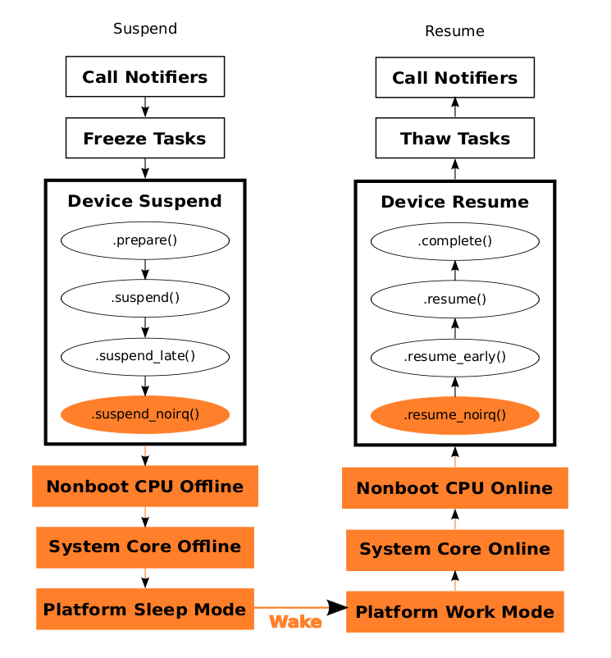
General System Suspend/Resume Control Flow
Power Management In The Linux* Kernel - Rafael J. Wysocki

Slide 17
Problem
How to reduce system idle power?

Slide 18
Problem
How to reduce system idle power?
What about CPU Hotplugging?

Slide 19
Problem
How to reduce system idle power?
What about CPU Hotplugging?
Expensive latency
Solution?

Slide 20
Problem
How to reduce system idle power?
What about CPU Hotplugging?
Expensive latency
Solution?
S2I(Suspend to Idle)

Slide 21
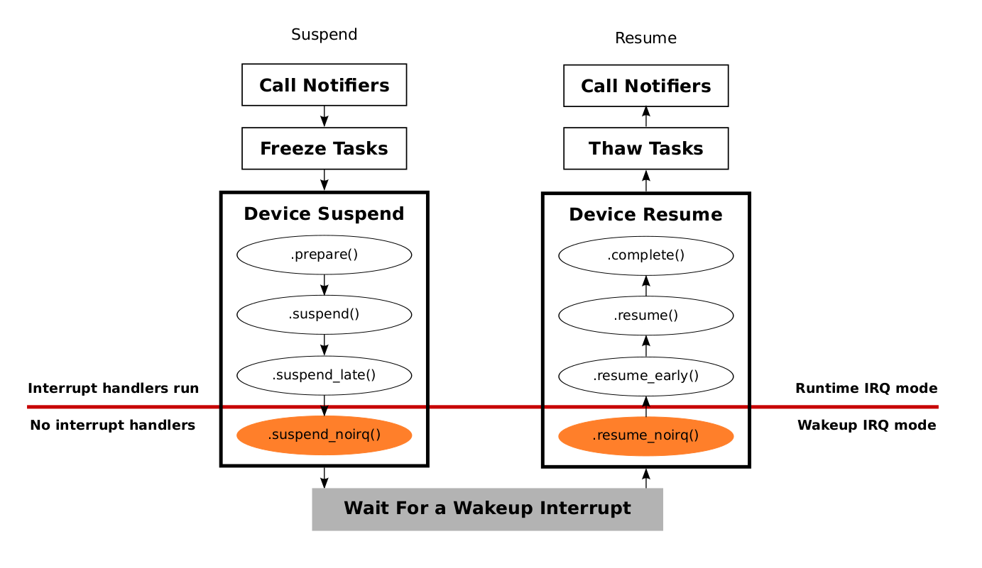
Suspend-to-Idle
https://www.linaro.org/blog/suspend-to-idle/

Slide 22
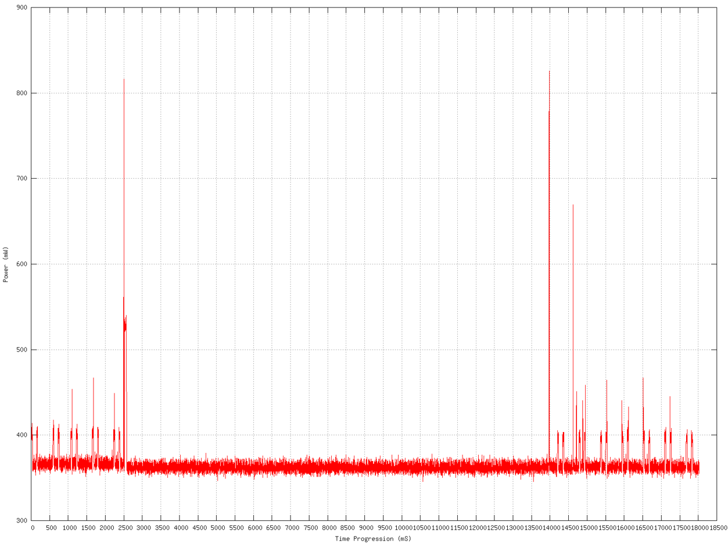
Suspend-to-Idle

Slide 23
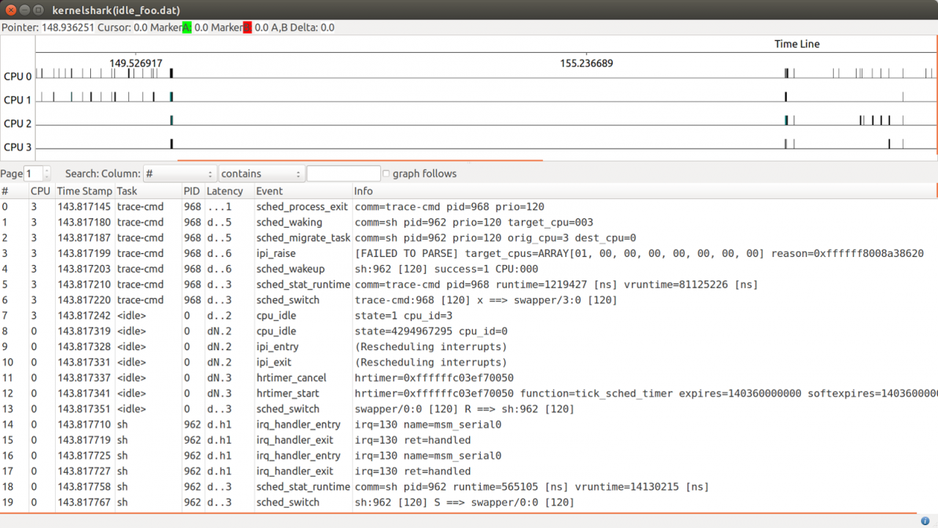
Suspend-to-Idle
https://www.linaro.org/blog/suspend-to-idle/

Slide 24
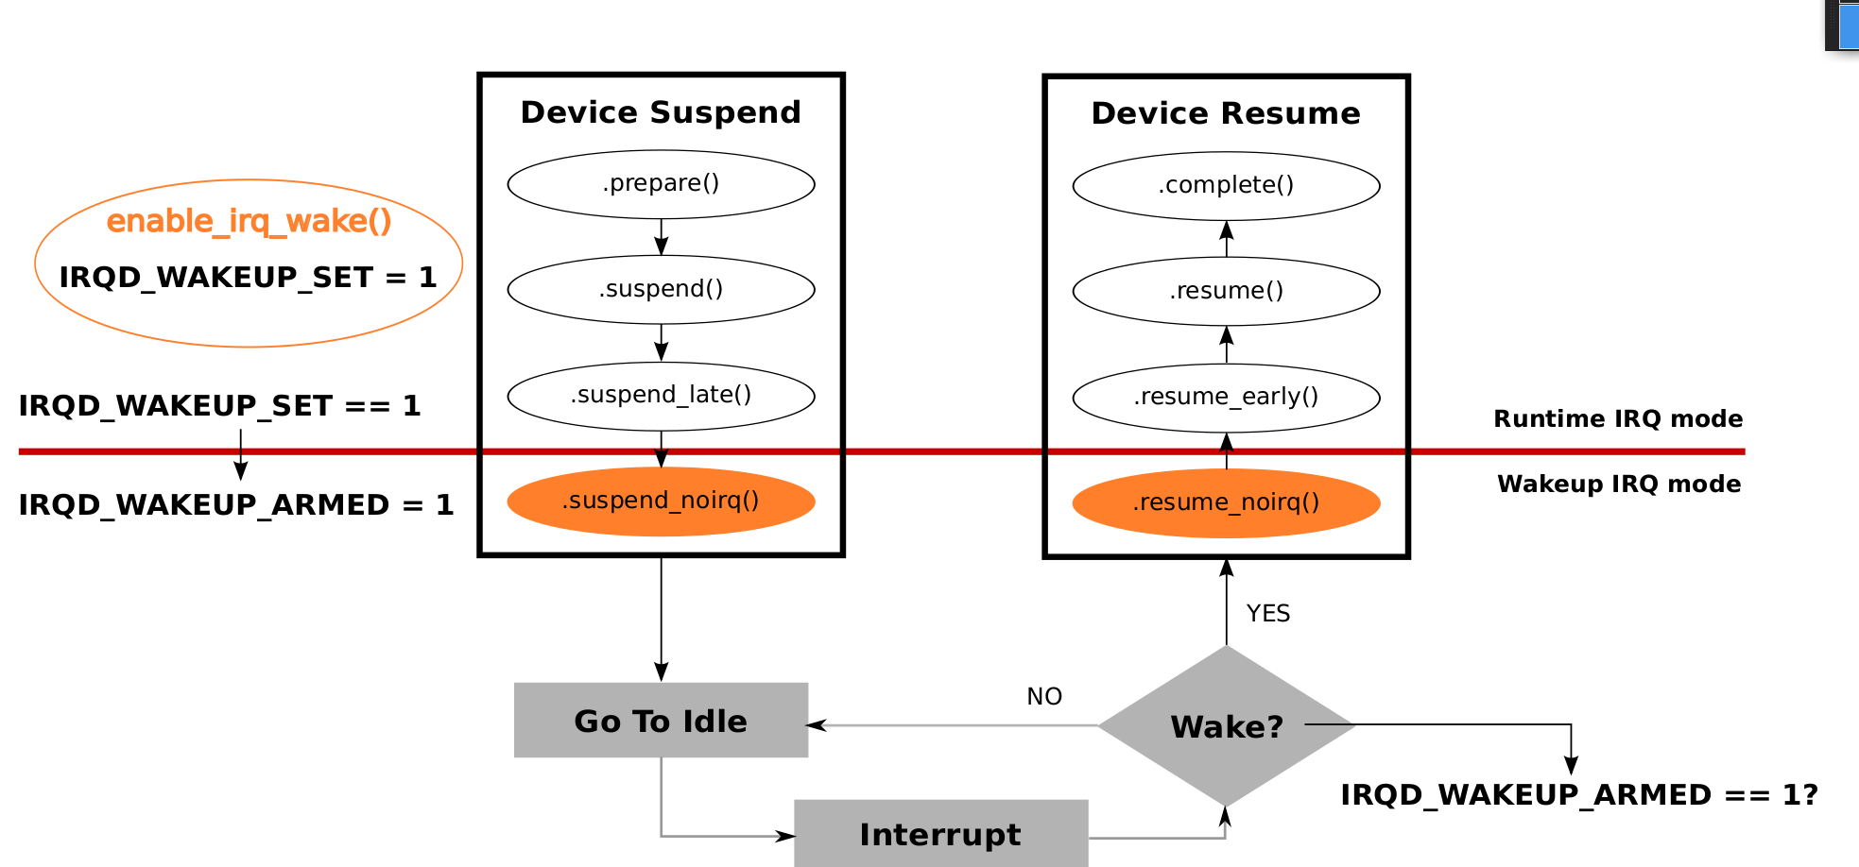
Suspend-to-Idle Wakeup
“What Is Suspend-to-Idle and How To Make It Work”, Rafael J. Wysocki

Slide 25
Tree view - Dynamic and Static PM
Reference from "Introduction to Kernel Power Management" Kevin Hilman, Linaro

Slide 26
Linux Power Framework
https://wiki.linaro.org/WorkingGroups/PowerManagement/Doc/Architecture
Source : https://wiki.linaro.org/WorkingGroups/PowerManagement/Doc/Architecture

Slide 27
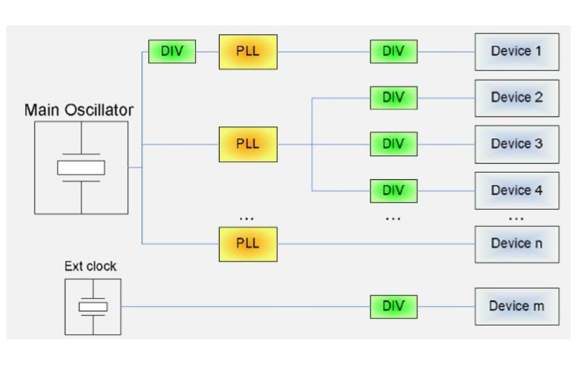
Clock Framework
Clock Domains

Slide 28
Clock Framework – function list
clk_get
Lookup and obtain a reference to a clock producer
clk_enable
Inform the system when the clock source should be running.
clk_disable
Inform the system when the clock source is no longer required.
clk_put
“free” the clock source

Slide 29
Tree view - Dynamic and Static PM
Reference from "Introduction to Kernel Power Management" Kevin Hilman, Linaro

Slide 30
Linux Power Framework
https://wiki.linaro.org/WorkingGroups/PowerManagement/Doc/Architecture
Source : https://wiki.linaro.org/WorkingGroups/PowerManagement/Doc/Architecture

Slide 31
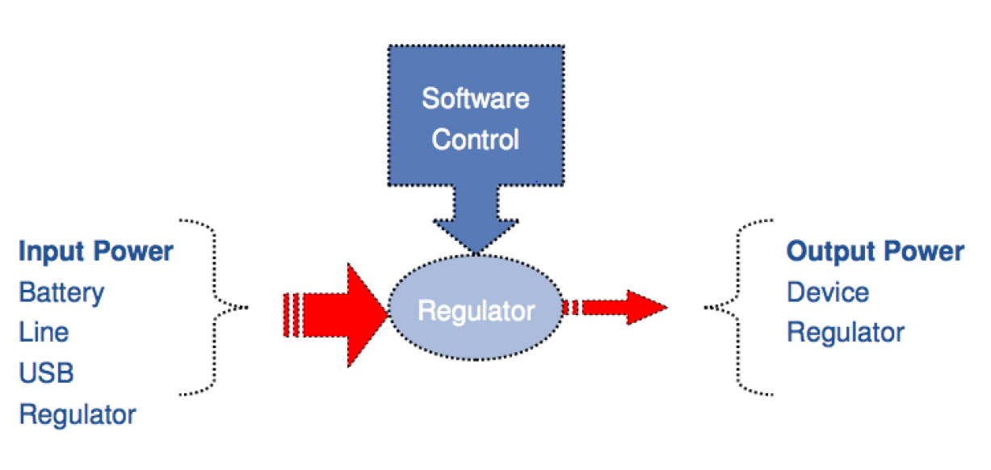
Regulator Framework - 1

Slide 32
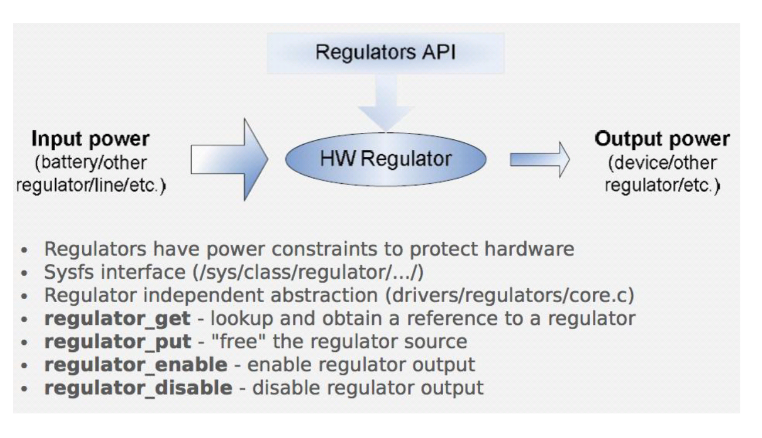
Regulator Framework - 4

Slide 33
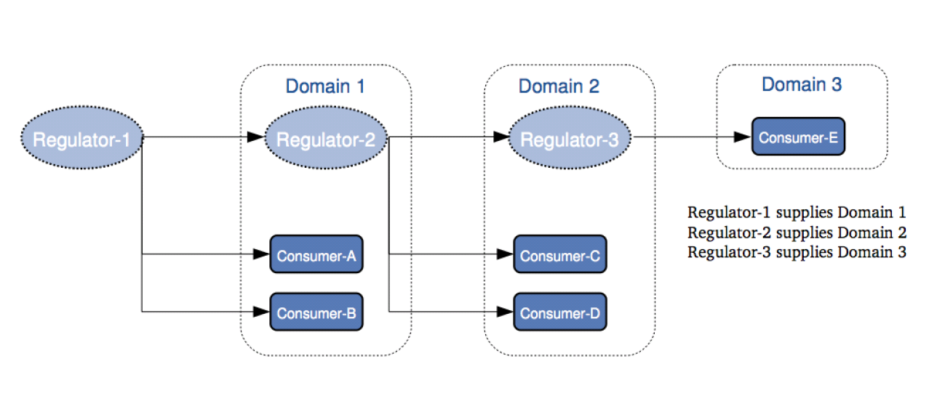
Regulator Framework - 2

Slide 34
Tree view - Dynamic and Static PM
Reference from "Introduction to Kernel Power Management" Kevin Hilman, Linaro

Slide 35
Linux Power Framework
https://wiki.linaro.org/WorkingGroups/PowerManagement/Doc/Architecture
Source : https://wiki.linaro.org/WorkingGroups/PowerManagement/Doc/Architecture

Slide 36
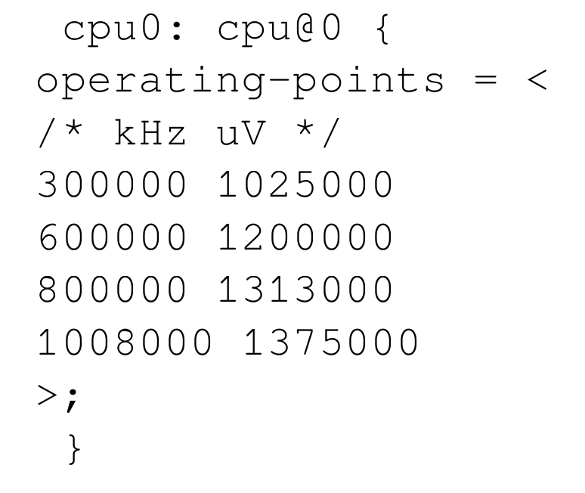
OPP - Operating Performance Point
Tuple of frequency, minimum voltage.
Described in DT

Slide 37
Linux Power Framework
https://wiki.linaro.org/WorkingGroups/PowerManagement/Doc/Architecture
Source : https://wiki.linaro.org/WorkingGroups/PowerManagement/Doc/Architecture

Slide 38
Tree view - Dynamic and Static PM
Reference from "Introduction to Kernel Power Management" Kevin Hilman, Linaro

Slide 39
CPU Frequency Governor
4.5 and Earlier version of Linux -

Slide 40
CPU Frequency Subsystem
Linux CPU frequency subsystem manages CPU frequency scaling.
CPU Frequency Subsystem
Governor
Sysfs
Core
Platform Driver

Slide 41
CPU Frequency Subsystem
Comprise three parts
Governor
Implemented CPU frequency scaling policy
Governors in Linux Kernel
Performance, Powersave, Userspace, Ondemand, Conservative, Interactive
Core
Provide generic interface for governor and platform driver to communicate with each other
Platform driver
SoC-chip specific cpu frequency scaling driver
Thermal throttle, DVFS, and so on

Slide 42
Governors In Linux Kernel
Powersave governor
Set frequency statically to lowest available frequency.
Performance governor
Set frequency statically to highest available frequency.
Userspace governor
Set frequency manually.
Ondemand governor
Scale frequency based on CPU utilization.
Interactive governor
More responsive to interactive workloads.

Slide 43
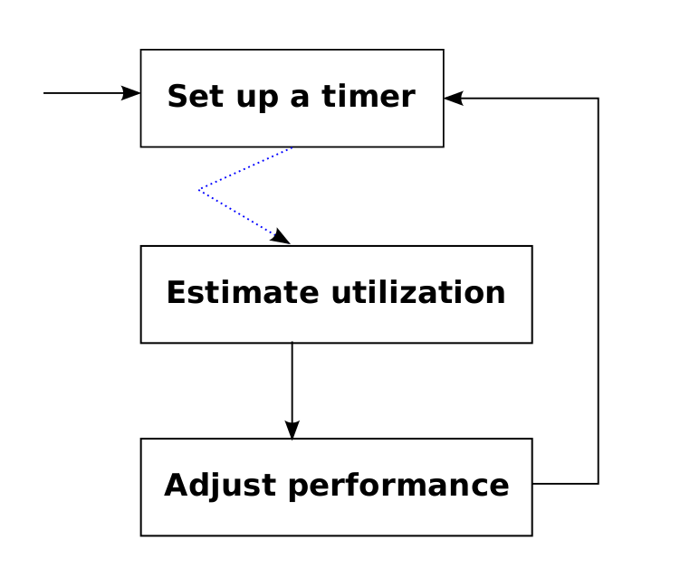
Governors In Linux Kernel
"CPUFreq and The Scheduler Revolution in CPU Power Management", Rafael J. Wysocki

Slide 44
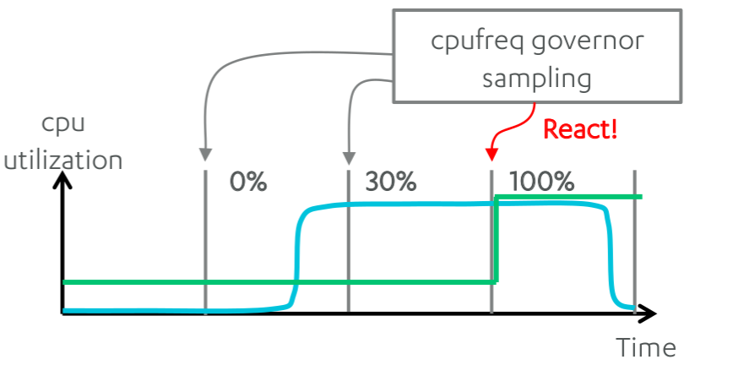
DVFS in Linux (cpufreq)
"EAS Update", Amit Kucheria et. ,al. ARM

Slide 45
Ex) Interactive Governor
Interactive
100
CPU
Idle
interactive
timer
85
go_hispeed_load
Touch screen input
Direct Call
wake_up_process
cpufreq_interactive_up_task
Set frequency to maximum
cpufreq_interactive_freq_down
Set frequency
Interactive

Slide 46
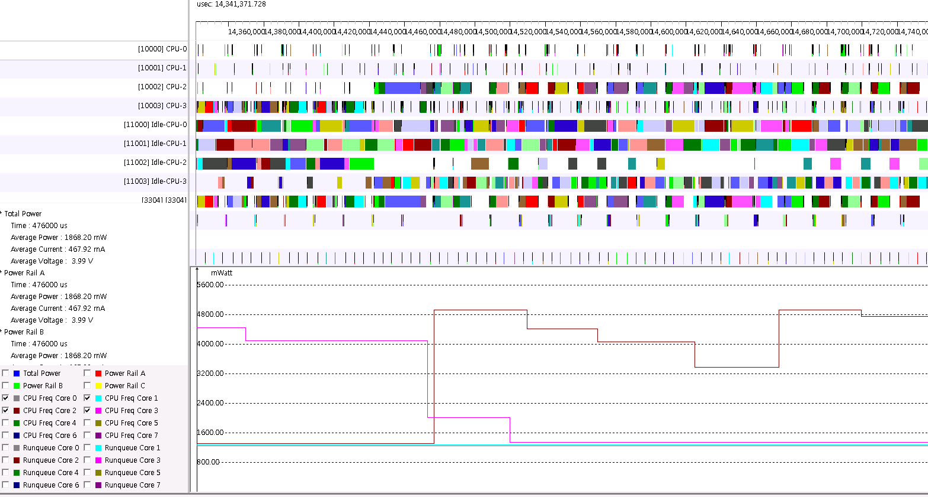
Interface
CPU-2 로드 증가
CPU-2 Frequency 증가
‹#›

Slide 47
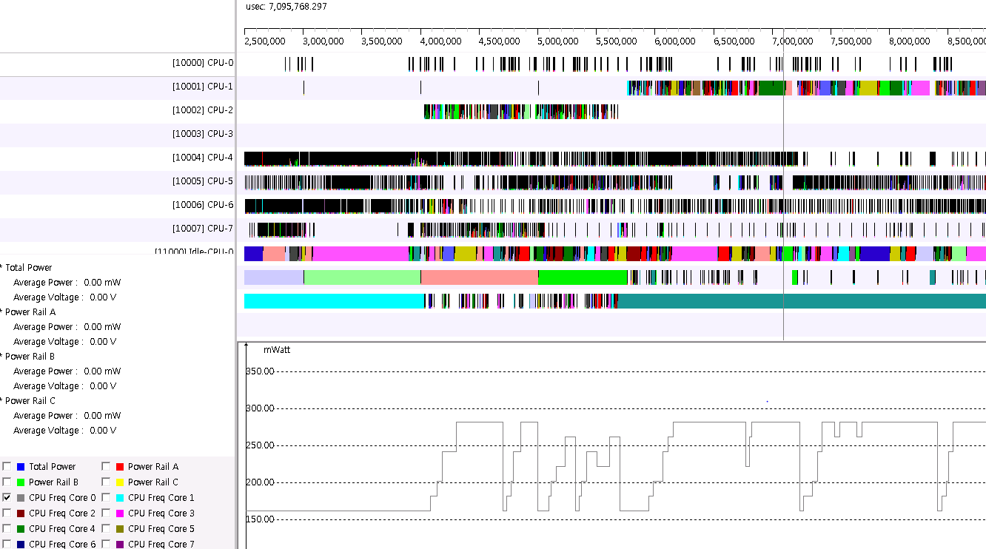
Boost
계단식 증가

Slide 48
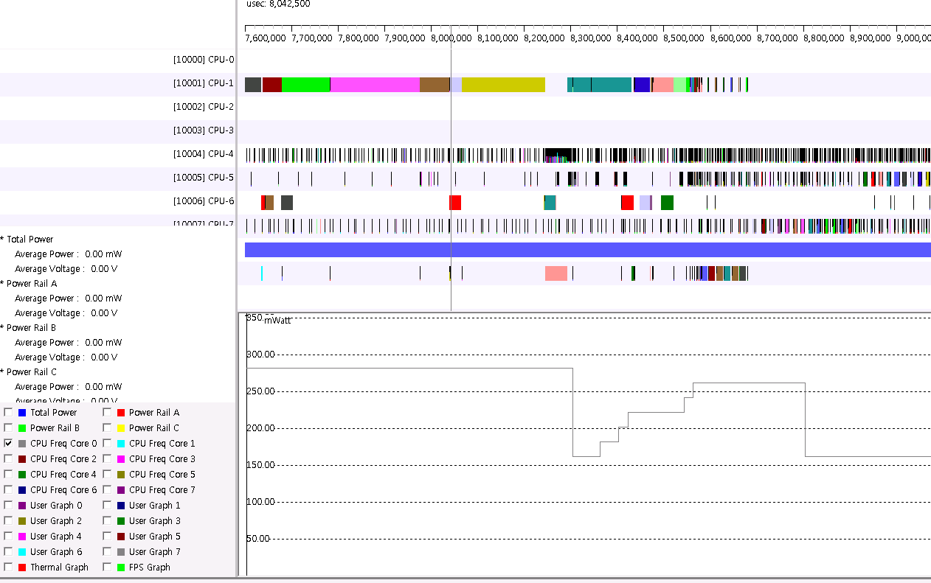
Floor validate_time
floor_validate_time
Default : 80ms

Slide 49
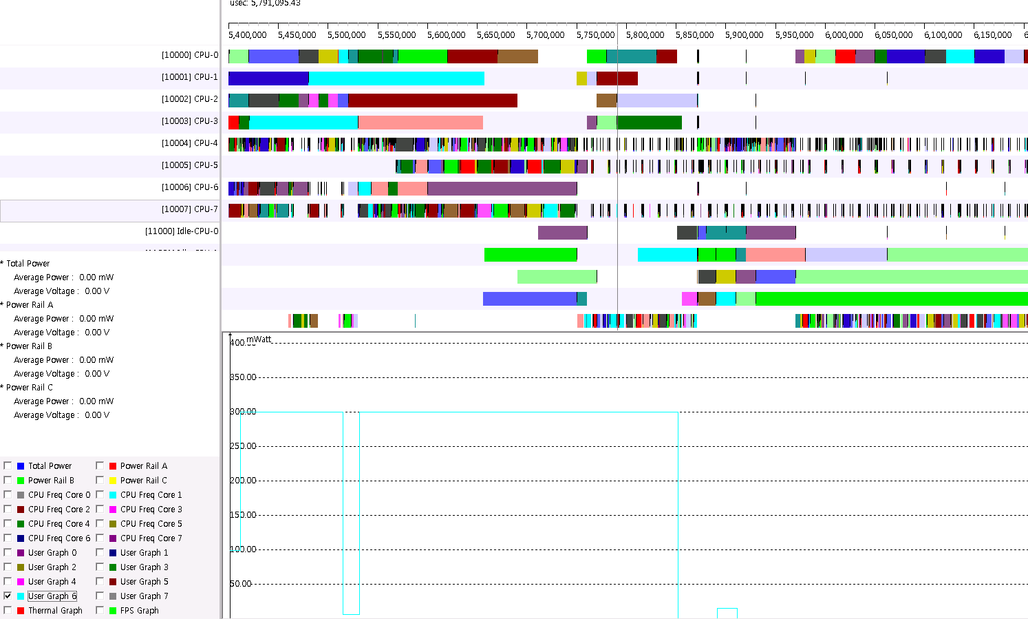
Deferrable timer
하늘색
CPU 6 CPU LOAD
IDLE 진입, 하지만
CPU Load는 높다.

Slide 50
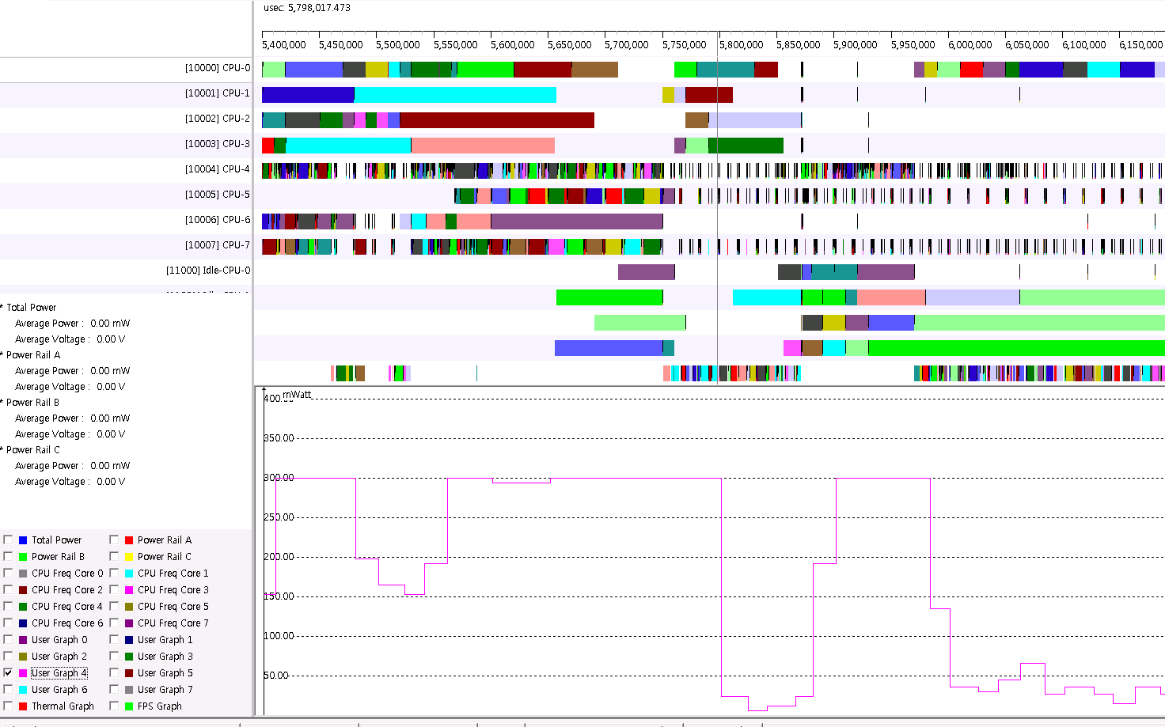
Deferrable timer
분홍색
CPU 4 CPU LOAD
IDLE 진입, 하지만
CPU Load는 높다.

Slide 51
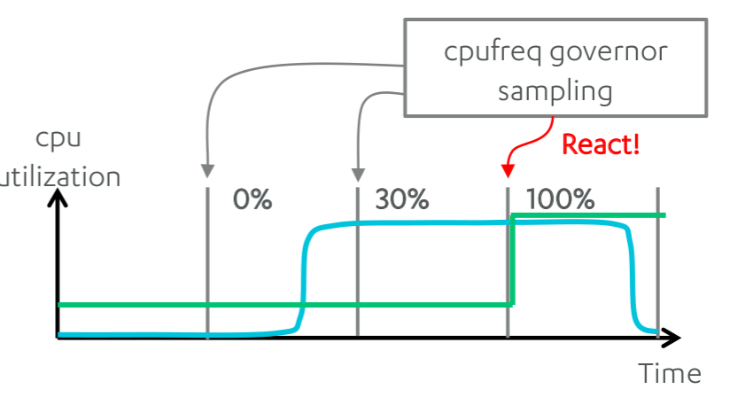
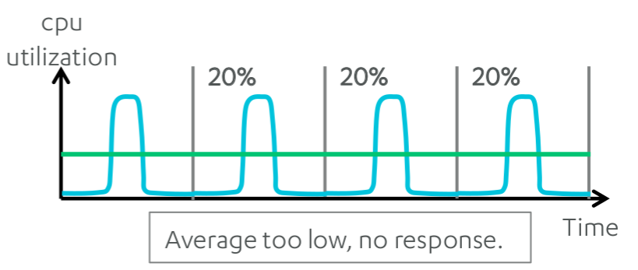
DVFS in Linux (cpufreq)
Problem
Sampling based governors are slow to respond and hard to tune.
Sampling too fast
Freq changes for small utilization spikes.
Sampling too slow
Average too low
"EAS Update", Amit Kucheria et. ,al. ARM

Slide 52
Tree view - Dynamic and Static PM
Reference from "Introduction to Kernel Power Management" Kevin Hilman, Linaro

Slide 53
Linux Power Framework
https://wiki.linaro.org/WorkingGroups/PowerManagement/Doc/Architecture
Source : https://wiki.linaro.org/WorkingGroups/PowerManagement/Doc/Architecture

Slide 54
PM_QOS
Goal : to reduce energy
A coordination mechanism
User’s performance needs
Examples
PM QoS with cpuidle
Per-device PM QoS with runtime pm.
Notes:
Examples:
PM QoS provides a coordination mechanism between the hardware providing a power managed resource and users with performance needs
PM QoS and cpuidle
The cpu_dma_latency requests are delivered to the cpuidle framework, based on them cpuidle makes decision to what next C state it will be allowed to put mpu. To receive that request the cpuidle framework have registered with PM QoS framework for that QoS class. The cpu_dma_latency is a minimum latency needed by device driver to process requests in time.
PM QoS and platform bus (interconnect).
The memory_throuput class frequently used to ask platform bus throughput. The recipient in that case is platform bus and users are device drivers. Depending on the asked maximum throughput in the request list the proper frequency is set for platform bus.
per-device PM QoS and runtime_pm.
The devices often support a range of runtime power states, which might use names such as "off", "sleep", "idle", "active", and so on. As in case with C states in cpuidle, different power states for device have different latencies based on what the next power state is chosen.
Devices are often included in power domains that means the power for a device is gained/retained only when all devices in that power domain are inactive, in other words they have common power states. Each power state has its own latency and this latency is main criteria to chose the next power state.

Slide 55
Linux Power Framework
https://wiki.linaro.org/WorkingGroups/PowerManagement/Doc/Architecture
Source : https://wiki.linaro.org/WorkingGroups/PowerManagement/Doc/Architecture

Slide 56
Tree view - Dynamic and Static PM
Reference from "Introduction to Kernel Power Management" Kevin Hilman, Linaro

Slide 57
Processor Power Management
http://download.intel.com/embedded/technology/PowerManagementforEmbeddedApps.pdf

Slide 58
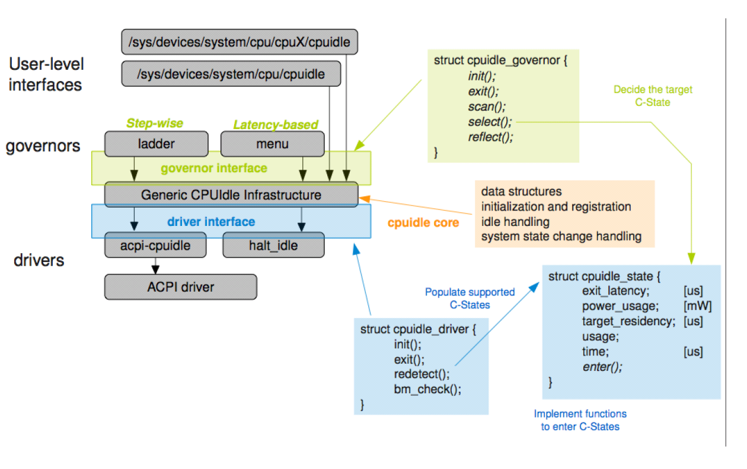
CPU idle - C-state management

Slide 59
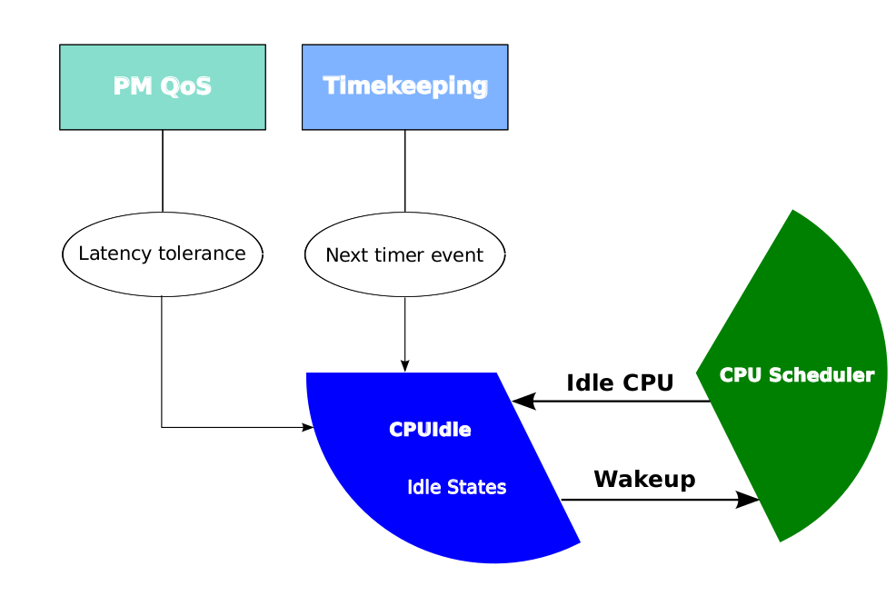
CPU idle

Slide 60
Menu governor: How deep to sleep?
Energy break
next timer event
historic behavior
Performance impact
nr_iowaiters, cpu_load
Latency tolerance
checks QoS (PM_QOS_CPU_DMA_LATENCY)

Slide 61
Per-device Power Management

Slide 62
Tree view - Dynamic and Static PM
Reference from "Introduction to Kernel Power Management" Kevin Hilman, Linaro

Slide 63
Linux Power Framework
https://wiki.linaro.org/WorkingGroups/PowerManagement/Doc/Architecture
Source : https://wiki.linaro.org/WorkingGroups/PowerManagement/Doc/Architecture

Slide 64
Runtime Power Management
Why’s Runtime PM
What’s Runtime PM
How’s Runtime PM

Slide 65
Problem
System sleep is not enough to decrease runtime energy consumption
Devices may depend on another device

Slide 66
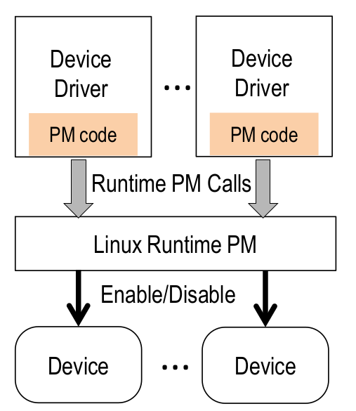
Why’s Runtime PM
System sleep is not enough to decrease runtime energy consumption
Devices may depend on another device
Solution
Runtime PM

Slide 67
Runtime PM callback and Helper Functions
ksrc/include/linux/pm.h :
struct dev_pm_ops {
…
int (*runtime_suspend)(struct device *dev);
int (*runtime_resume)(struct device *dev);
int (*runtime_idle)(struct device *dev);
};
Ksrc/include/linux/pm_runtime.h
pm_runtime_xxx();

Slide 68
Linux Support for Device Runtime PM
Track the number of concurrent users of device
use a per-device reference counter
_get(), _put()

Slide 69
Runtime PM API: _get(), _put()
Tell PM core whether device is in use
I need the device
pm_runtime_get(), _sync(), _noresume()
Increment use count, pm_runtime_resume()
I'm done
pm_runtime_put(), _sync, _noidle()
Decrement use count, pm_runtime_idle()

Slide 70
Autosuspend
Some device should not allow devices to be suspend
until they have been inactive for some minimum period.
A common heuristic
similarly a way of PM qos
Init
pm_runtime_set_suspended(dev);
pm_runtime_use_autosuspend(dev);
pm_runtime_set_autosuspend_delay(dev, DELAY);
I need the device
pm_runtime_get_sync(dev);
I'm done
pm_runtime_put_sync_autosuspend(dev);

Slide 71
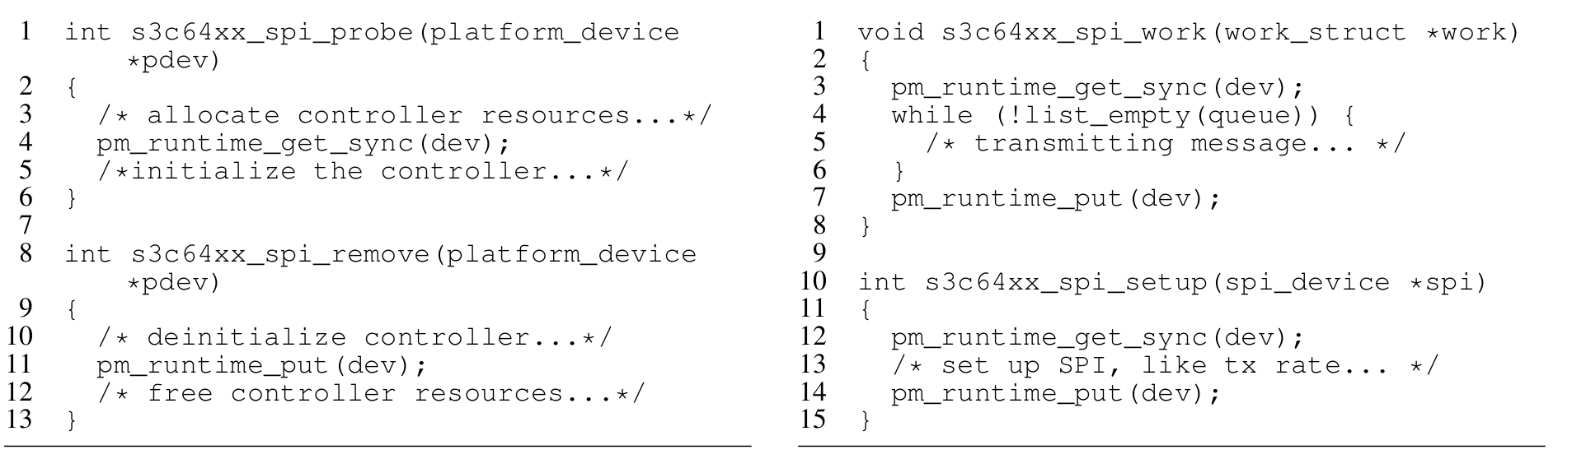
However, Real world - Runtime PM
Exynos SPI driver
Runtime PM often supported after long delay.
Hand-tuned PM in the Exynos SPI driver

Slide 72
However, Real world - Runtime PM
Complex drivers make it hard to do runtime PM.
It is similar with a Lock.
The impact of bad drivers.
Because clock, power, voltage depends on the domains.
sharing the same clock source.
sharing the same power
sharing the same voltage

Slide 73
Hotplug
https://wiki.linaro.org/WorkingGroups/PowerManagement/Doc/Architecture
Source : https://wiki.linaro.org/WorkingGroups/PowerManagement/Doc/Architecture

Slide 74
NOHZ_IDLE
Reference from "Introduction to Kernel Power Management" Kevin Hilman, Linaro

Slide 75
Queue work on power efficient wq
Problem
Work-queues can be performance or power oriented.
keep them running on a single cpu
it remains cache hot
but consider big.LITTLE platform

Slide 76
Queue work on power efficient wq
Problem
Work-queues can be performance or power oriented.
keep them running on a single cpu
it remains cache hot
but consider big.LITTLE platform
Solution
Power oriented WQ
Give scheduler the liberty
to choose target cpu for running work handler.
Power efficient WQ
workqueue is allocated with WQ_UNBOUND flag
Idle time for many cpus has increased considerably on big.LITTLE platform

Slide 77
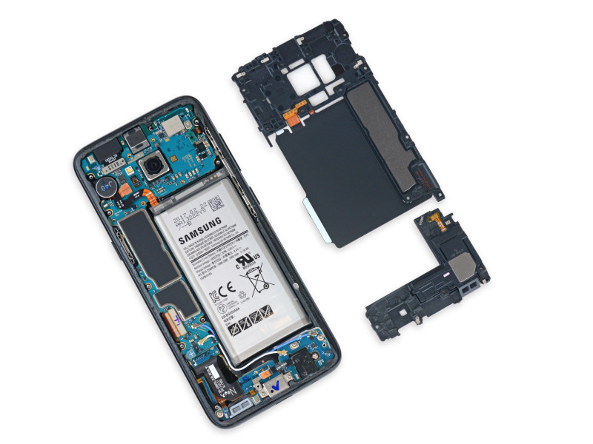
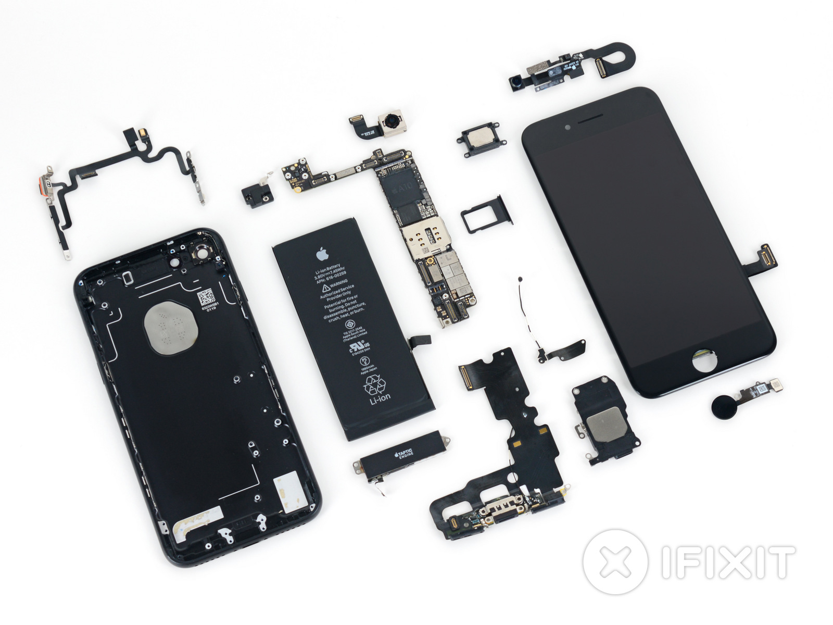
Thermal - iphone, galaxy

Slide 78
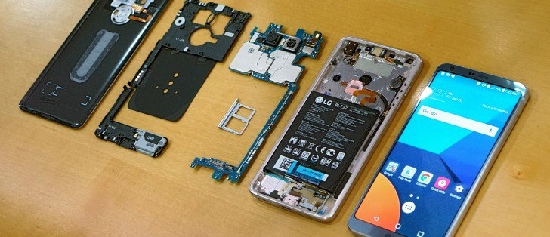
Thermal - G6

Slide 79
Thermal
Problem?

Slide 80
Thermal
Spread out

Slide 81
Today
process/thread -> performance -> multi-core performance scalability-> lock-> bottleneck-> cache cohere system problem-> per-core partition approach

Slide 82

Next Step.
Energy-aware scheduling: EAS
CFS scheduler(User level, Tools, Kernel level)
Load Balancer(Group Scheduling, Bandwidth Control, PELT)
EAS features

Slide 83
Reference
https://pdos.csail.mit.edu/6.828/2016/schedule.html
http://web.mit.edu/6.033
http://www.rdrop.com/~paulmck/
“Is Parallel Programming Hard, And If So, What Can You Do About It?”
Davidlohr Bueso. 2014. Scalability techniques for practical synchronization primitives. Commun. ACM 58
http://queue.acm.org/detail.cfm?id=2698990
"CPUFreq and The Scheduler Revolution in CPU Power Management", Rafael J. Wysocki
https://sites.google.com/site/embedwiki/oses/linux/pm/pm-qos
https://intl.aliyun.com/forum/read-916
User-level threads : co-routines
http://www.gamedevforever.com/291
https://www.youtube.com/watch?v=YYtzQ355_Co
Scheduler Activations
https://cgi.cse.unsw.edu.au/~cs3231/12s1/lectures/SchedulerActivations.pdf
https://en.wikipedia.org/wiki/FIFO_(computing_and_electronics)
http://jake.dothome.co.kr/
http://www.linuxjournal.com/magazine/completely-fair-scheduler?page=0,0
https://www2.cs.uic.edu/~jbell/CourseNotes/OperatingSystems/6_CPU_Scheduling.html
"Energy Aware Scheduling", Byungchul Park, LG Electronic
“Update on big.LITTLE scheduling experiments”, ARM
“EAS Update” 2015 september ARM
"EAS Overview and Integration Guide”, ARM TR
“Drowsy Power Management”, Matthew Lentz, SOSP 2015
https://www.slideshare.net/nanik/learning-aosp-android-hardware-abstraction-layer-hal
https://www.youtube.com/watch?v=oTGQXqD3CNI
https://www.youtube.com/watch?v=P80NcKUKpuo
https://lwn.net/Articles/398470/
“SCHED_DEADLINE: It’s Alive!”, ARM, 2017

